Slide 1
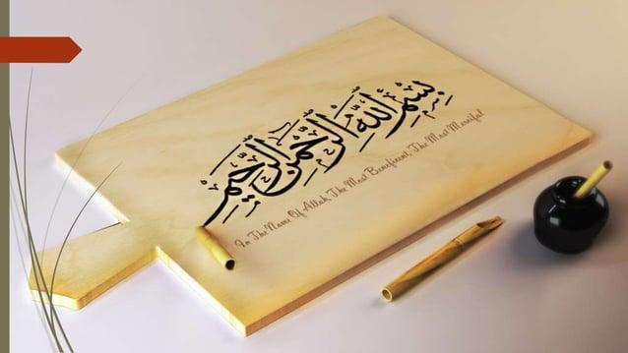

Slide 2
THE MESSAGE OF ISLAM AND PROPHETHOOD

Slide 3
FIRST REVELATION AND ITS IMPACTS
The first revelation was when Prophet Muhammad (PBUH) got the first message from Allah (God).
This happened in Cave Hira, near Makkah, in 610 CE.
It was the start of Islam and Prophet Muhammad’s (PBUH) mission.

Slide 4
What Happened?
Prophet Muhammad (PBUH) liked to pray alone in Cave Hira.
One night, in Ramadan, an angel named Jibreel (Gabriel) came.
The angel said: "Read!" (Iqra)
The Prophet (PBUH) said: "I cannot read."
The angel repeated it three times.
Then, the angel told him the first words of the Quran.

Slide 5
The First Verses of the Quran
Allah revealed these verses:
Read in the name of your Lord who created.
He created man from a small clot of blood.
Read! Your Lord is very kind.
He taught humans how to write.
He gave knowledge to people.

Slide 6
Prophet Muhammad’s (PBUH) Reaction
He was shocked and scared.
He ran home, shaking with fear.
He told his wife Khadijah (RA): "Cover me, cover me."
Khadijah (RA) comforted him and took him to Waraqa bin Nawfal, a wise man.
Waraqa said: "This is a message from Allah. You are a prophet.

Slide 7
The Start of Prophethood
This was the beginning of Islam.
Prophet Muhammad (PBUH) became the last prophet of Allah.
He started telling people to worship only one God (Allah).

Slide 8
Impacts of the First Revelation
🔹 Impact on Prophet Muhammad (PBUH):
He became stronger in faith.
He understood that he was chosen as a prophet.
He started preaching the message of Islam.
🔹 Impact on Society:
Before Islam, people worshipped idols and did wrong things.
Islam taught fairness, kindness, and truth.
People were told to worship only one God (Allah).

Slide 9
Impacts of the First Revelation
🔹 Opposition from the Quraysh
The Quraysh did not like Islam.
They wanted to keep idol worship and unfair ways.
They punished and hurt the Prophet (PBUH) and his followers.
🔹 Long-Term Changes
People started learning because Islam encouraged reading and knowledge.
Islam spread worldwide, bringing peace and justice.
Today, millions of people follow Islam and the teachings of the Quran.

Slide 10
Opposition from Quraish
Challenges Faced by prophet in Makkah
Reason: The Quraysh feared losing power, wealth, and idol worship at the Kaaba.
Tactics: Public ridicule, false accusations (calling him a magician/poet), and social boycott

Slide 11
Tactics
1. Negotiations : They bribed him with wealth and power to abandon Islam, but he refused, saying, "If they put the sun in my right hand and the moon in my left, I will not give up this mission."
2.Torture: Weak and poor Muslims faced brutal persecution—Bilal (RA) was dragged on burning sand, Ammar (RA)’s family was tortured to death.
3.Social Boycott: Banu Hashim was forced into exile in Shi’b Abi Talib (3 years of starvation and hardship).
4.Loss of Loved Ones: His wife Khadijah (RA) and uncle Abu Talib passed away, making him vulnerable.

Slide 12
The Painful Journey to Ta’if
Seeking Support: After years of opposition in Makkah, Prophet Muhammad (PBUH) traveled 60 miles to Ta’if, hoping its leaders would accept Islam and provide protection.Harsh
Rejection: The chiefs of Ta’if—Abd Yalayl, Mas’ud, and Habib—mocked him and refused to listen. They incited mobs to insult and attack him.Brutal Attack: As he walked through the streets, the people pelted him with stones, injuring him badly. His shoes filled with blood, yet he remained patient.
The Prophet’s Prayer: He took refuge in an orchard and made a heartfelt dua to Allah, expressing his sorrow but leaving everything to Him.
Angel Jibreel’s Offer: Allah sent Angel Jibreel (AS), who offered to destroy Ta’if. Instead of revenge, Prophet Muhammad (PBUH) prayed:"O Allah, guide them, for their children may accept Islam.
"Years Later: His patience bore fruit—Ta’if later embraced Islam willingly. This incident showed his unmatched mercy and perseverance.

Slide 13
The Night of Escape (Hijrah)
Quraysh’s Assassination Plot: The Quraysh leaders feared Islam’s growth and decided to kill Prophet Muhammad (PBUH). They chose one strong man from each tribe to attack him together, ensuring no single tribe would bear the blame.
Allah’s Command to Migrate: Prophet Muhammad (PBUH) was informed of their plot by Angel Jibreel (AS). He asked his cousin Ali (RA) to sleep in his bed, tricking the assassins.
The Miraculous Escape: As the Quraysh surrounded his house, he recited Surah Yaseen (36:9):"And We placed a barrier before them and a barrier behind them, so We covered them, and they could not see."He walked out unseen..

Slide 14
Why Did Muslims Migrate?
Persecution in Makkah: Quraysh were hurting and torturing Muslims.
No Freedom to Worship: Muslims could not pray openly.
Invitation from Madina: The people of Madina promised to support the Prophet (PBUH) and Islam.
Allah’s Command: Allah allowed the Prophet (PBUH) to migrate for safety and spreading Islam.

Slide 15
Migration to Madina (Hijrah)
What is Migration to Madina?
Migration (Hijrah) means moving from one place to another.
Prophet Muhammad (PBUH) and his followers migrated from Makkah to Madina.
This happened in the year 622 CE.
It was a big turning point for Islam.

Slide 16
Arrival In Madina
The people of Madina (Ansar) warmly welcomed the Prophet (PBUH) and Muslims.
The Prophet (PBUH) built the first mosque (Masjid Quba).
Brotherhood was created between the people of Madina (Ansar) and Makkah (Muhajireen).

Slide 17
Impact of migration to madinah
Islam Grew Stronger
In Madina, Islam spread freely.
Prophet Muhammad (PBUH) established an Islamic state.
Peace and Brotherhood
The Ansar (Helpers) and Muhajireen (Migrants) became like brothers.
Society became fair and peaceful.
Laws and Justice
The Prophet (PBUH) created the first Islamic government.
New rules for justice, trade, and worship were made.
A Safe Place for Muslims
Muslims were no longer afraid of persecution.
They could worship Allah freely.

